Slide 1
Microsevices cont…

Slide 2

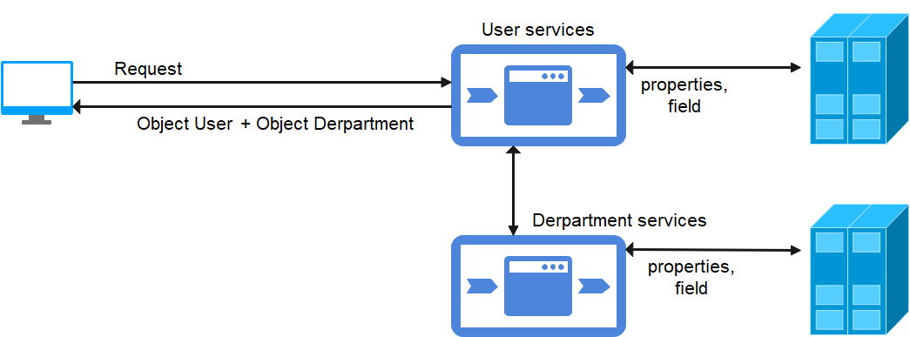
Make example

Slide 3
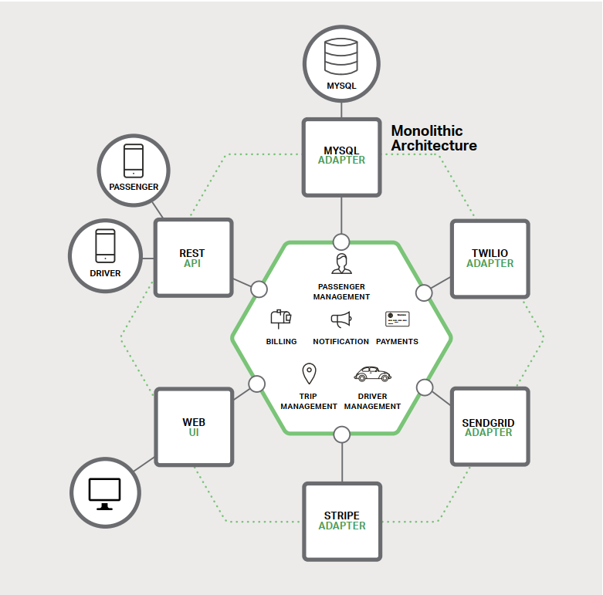
Monolithic

Slide 4
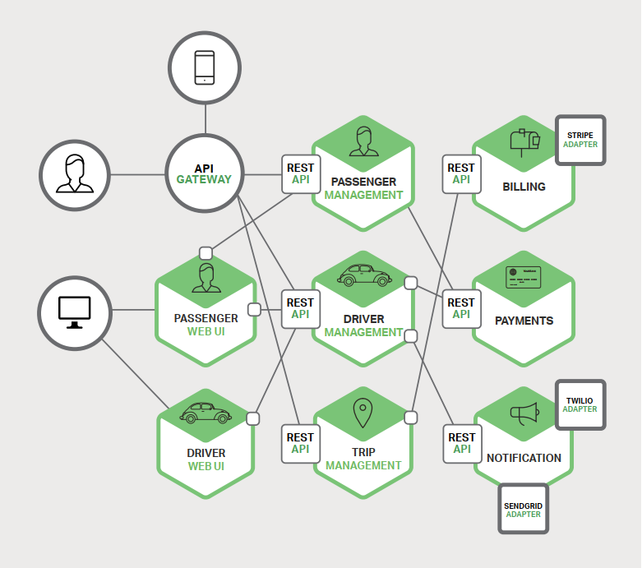
Microservice

Slide 5
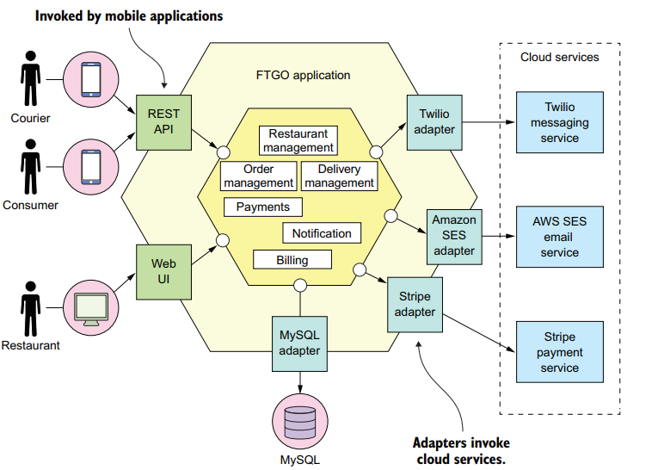
Monolithic

Slide 6
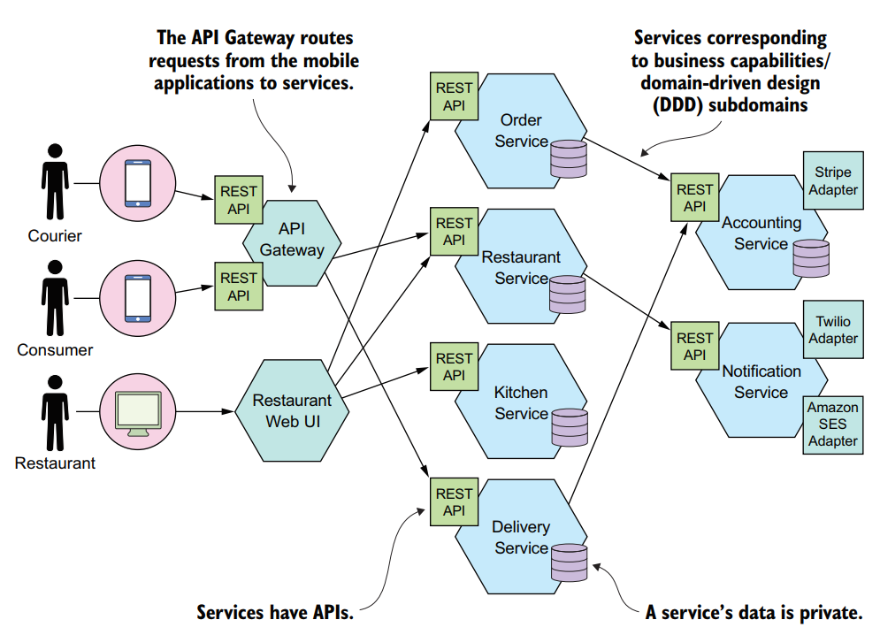
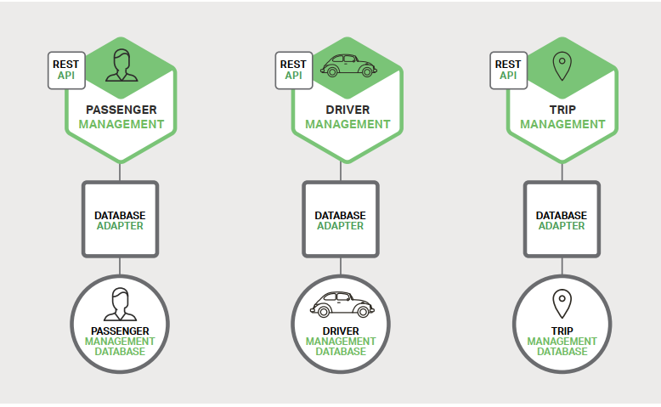
Microservice

Slide 7
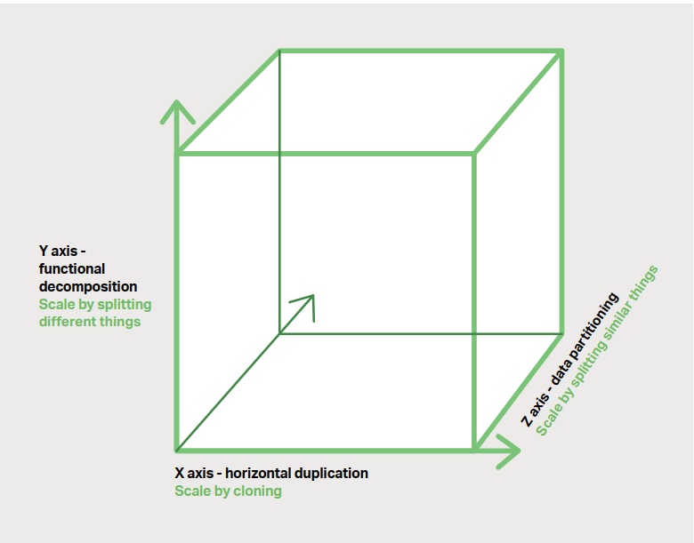
Scale

Slide 8
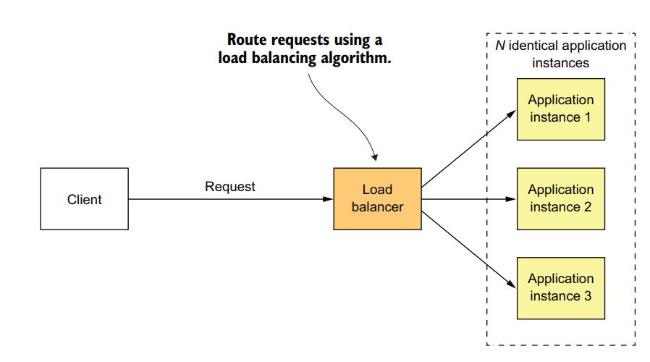
Load Balancer-Monolithic

Slide 9
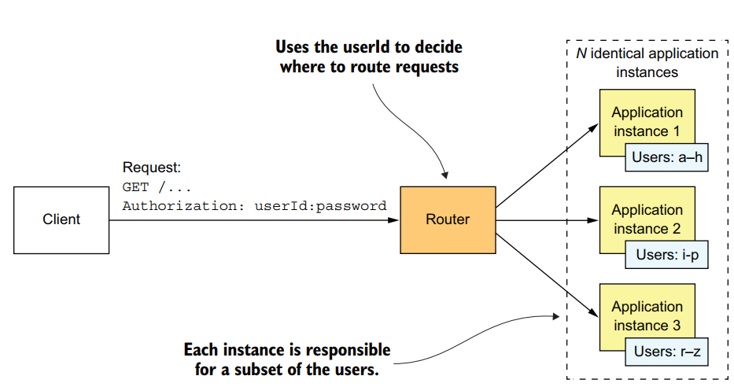
Load Balancer-Monolithic

Slide 10
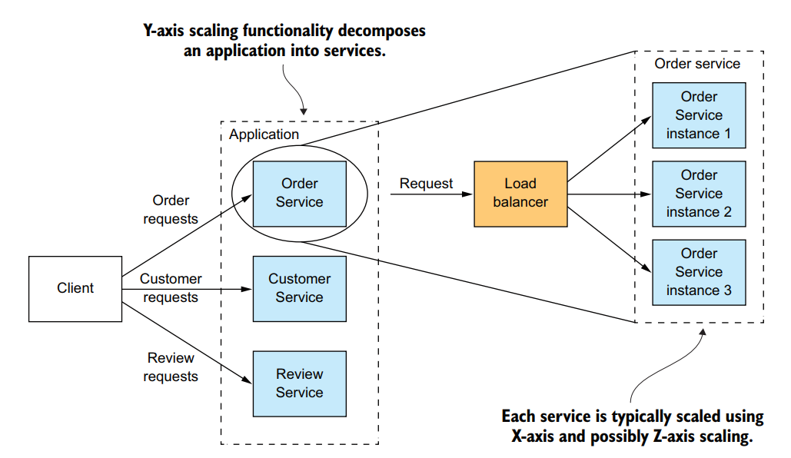
Load Balancer-Microservice

Slide 11
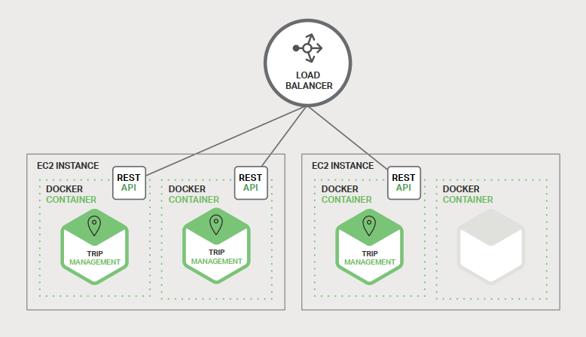
Load Balancer

Slide 12
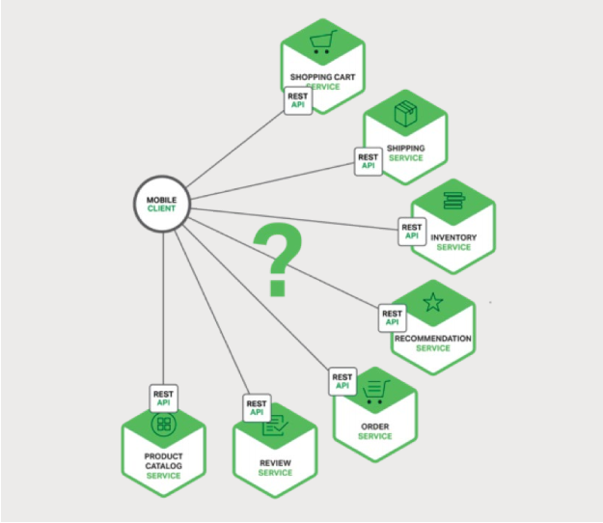
Need

Slide 13
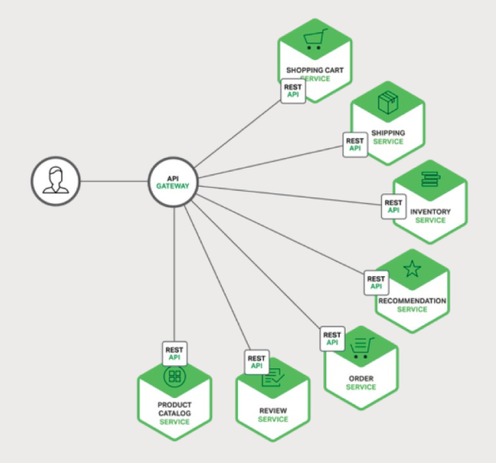
Need

Slide 14
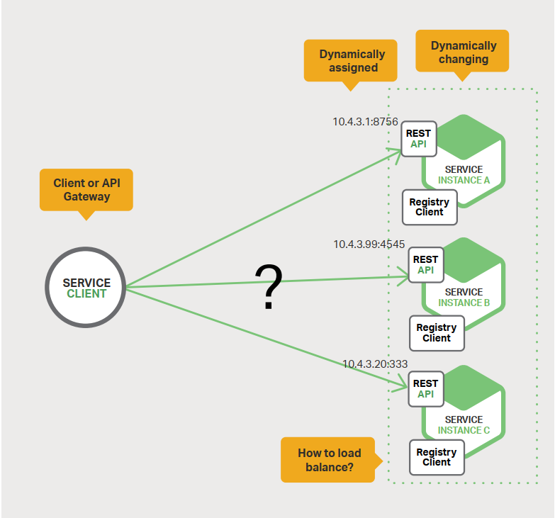
Service Discovery

Slide 15
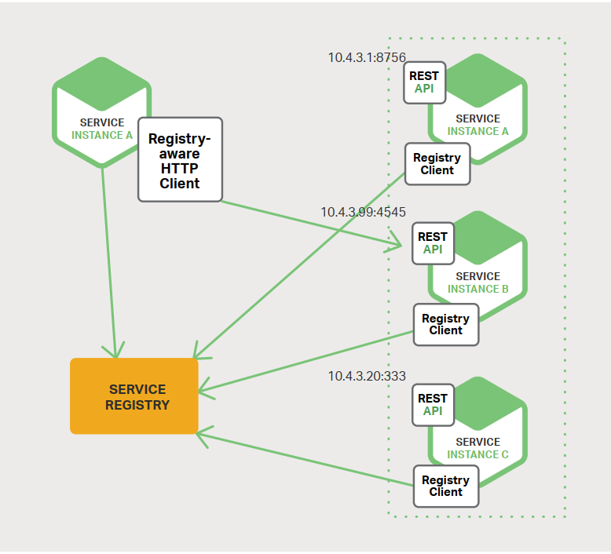
Service registry

Slide 16
Eureka client-server

Slide 17
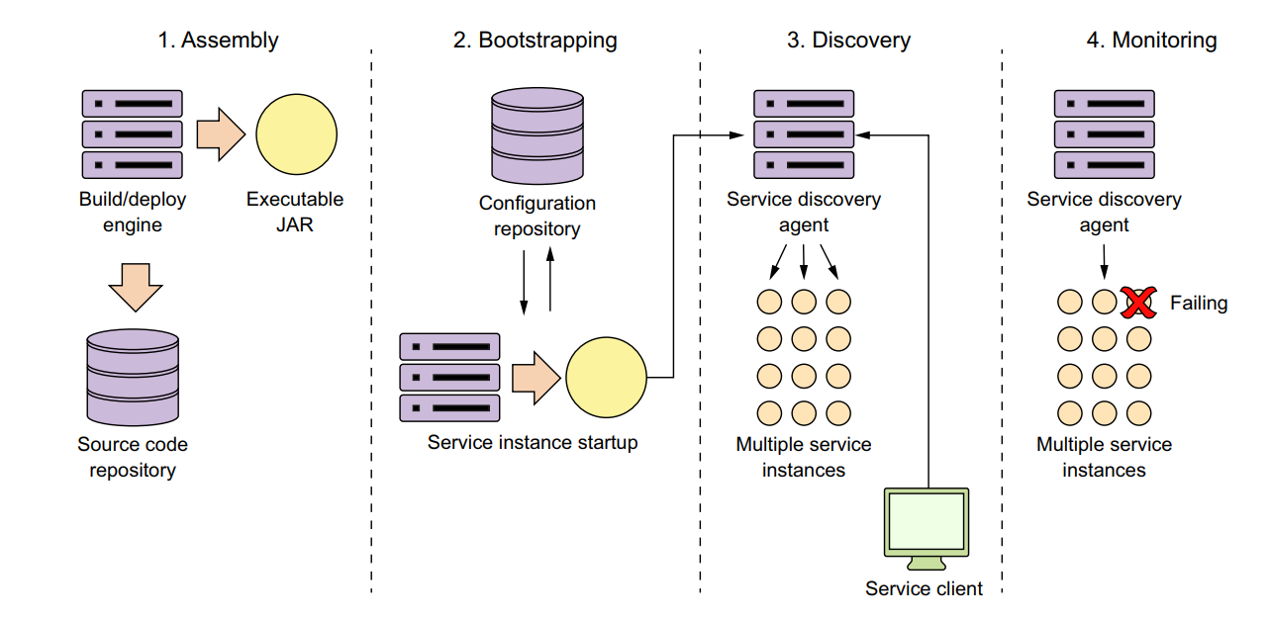
Microservice start up

Slide 18
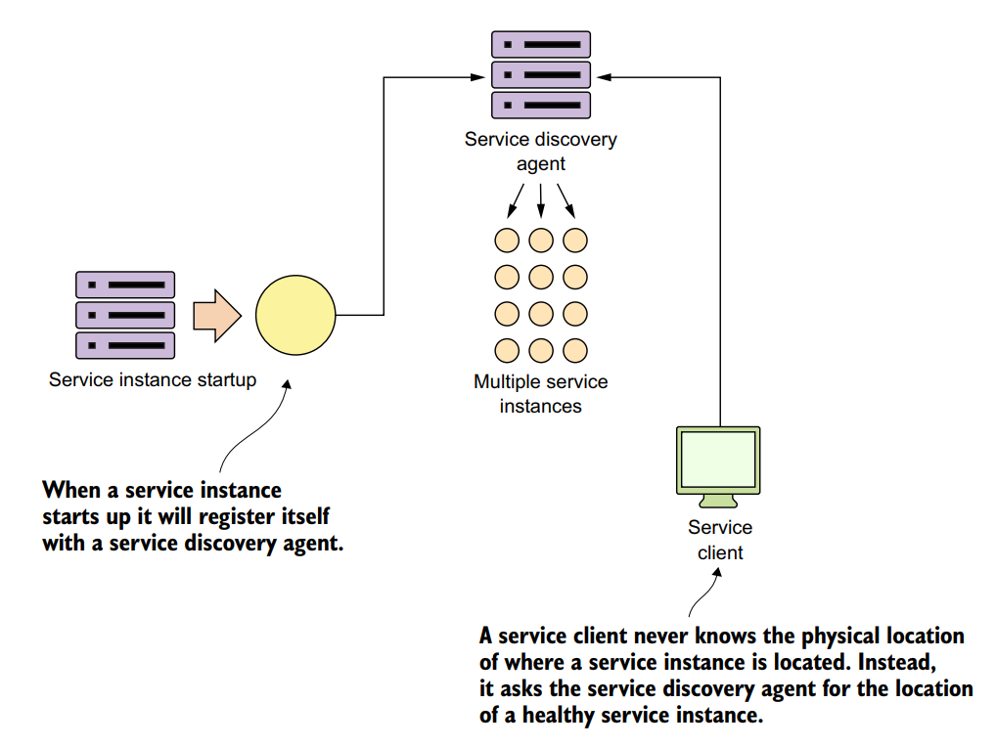
Service discovery

Slide 19
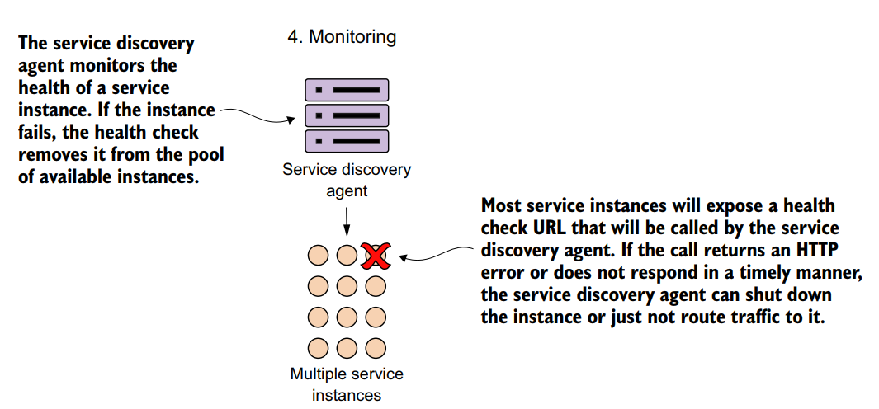
Monitoring

Slide 20
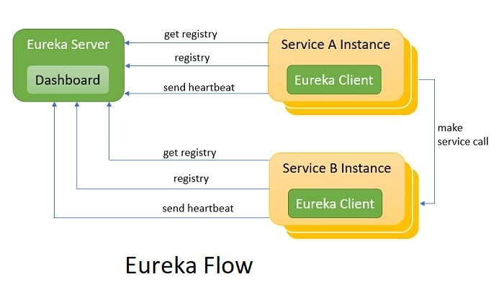
Eureka flow

Slide 21

Service Registry

Slide 22

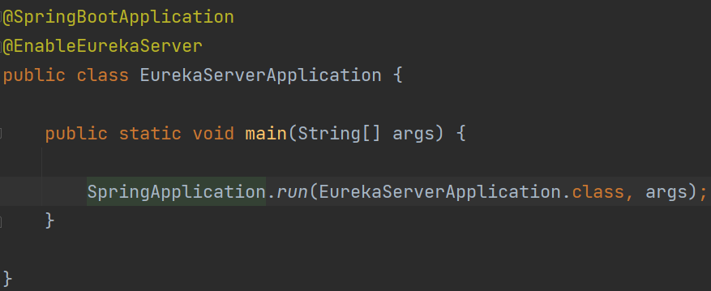
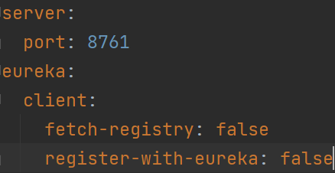
Eureka server

Slide 23
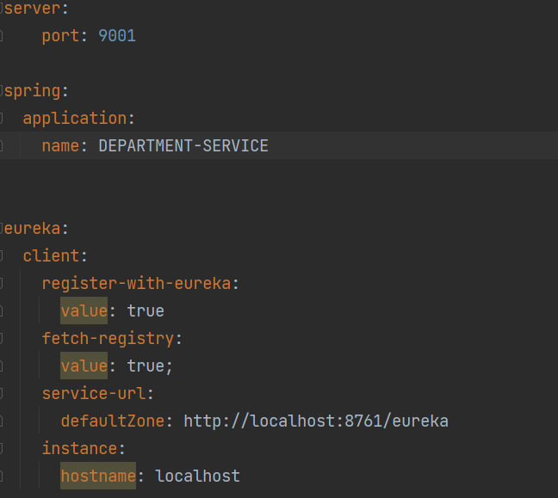
Eureka client

Slide 24
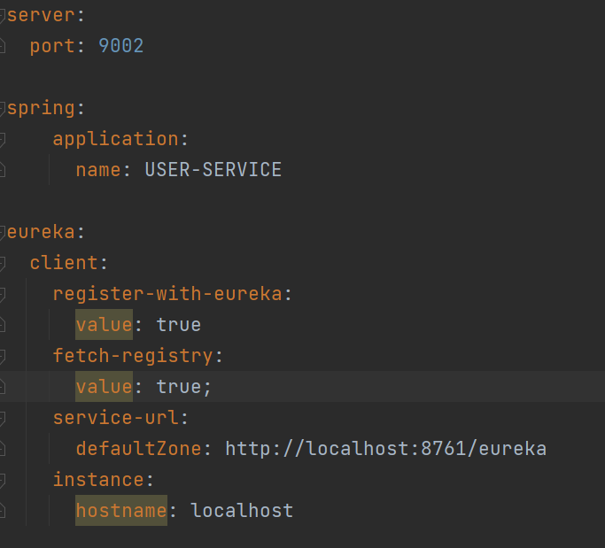
Eureka client

Slide 25
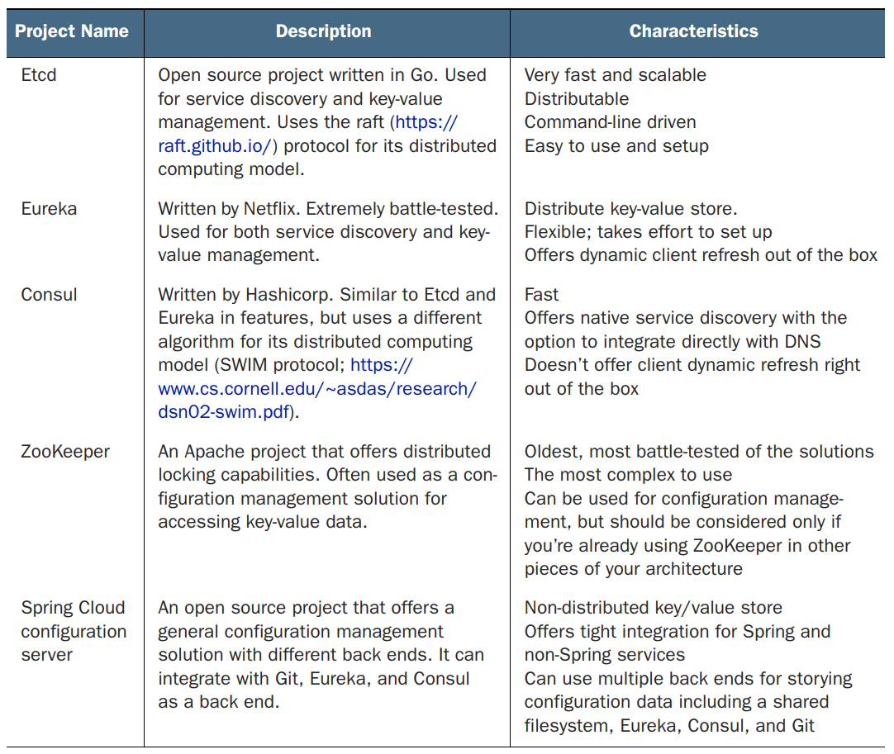
Spring Cloud Config Server

Slide 26
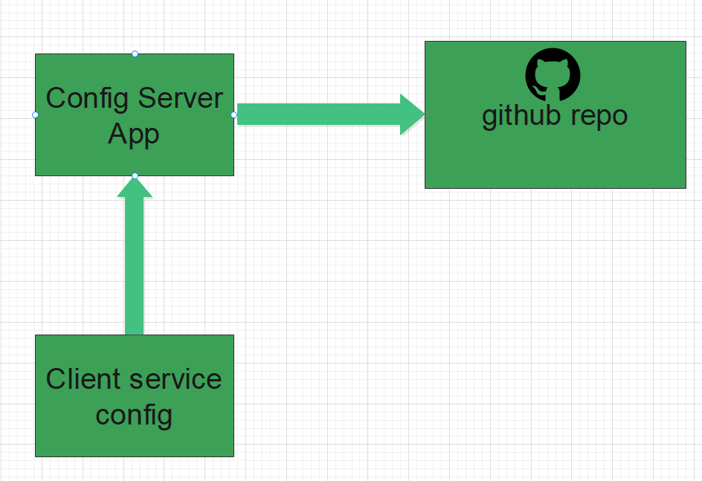
Spring boot config server

Slide 27
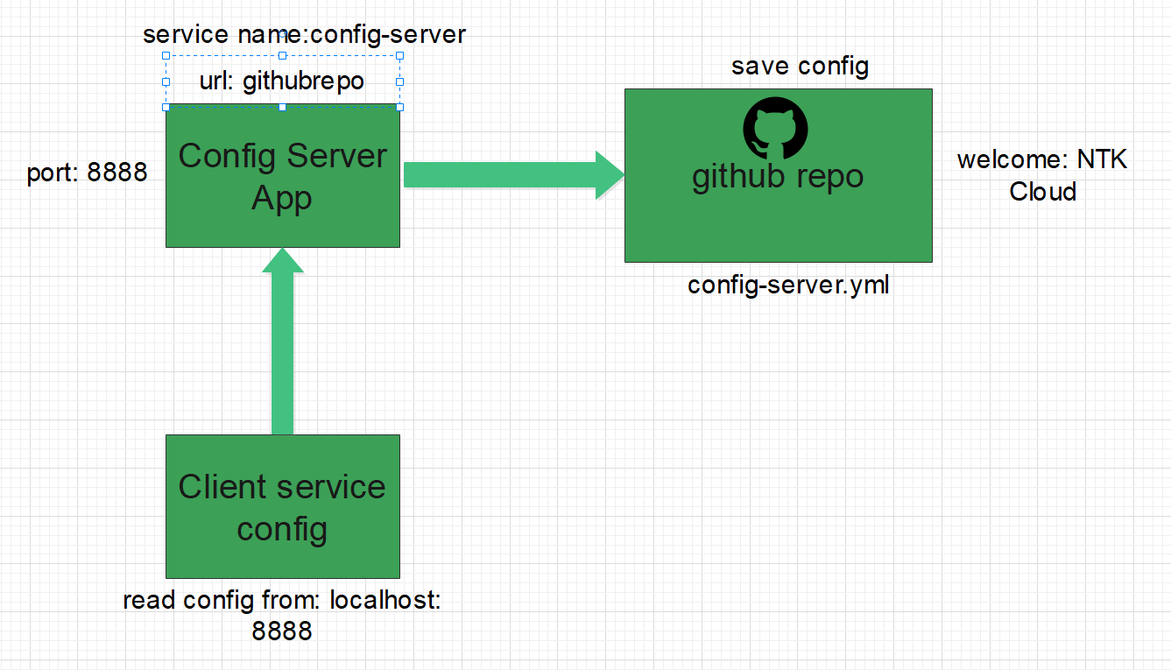
Spring boot config server

Slide 28
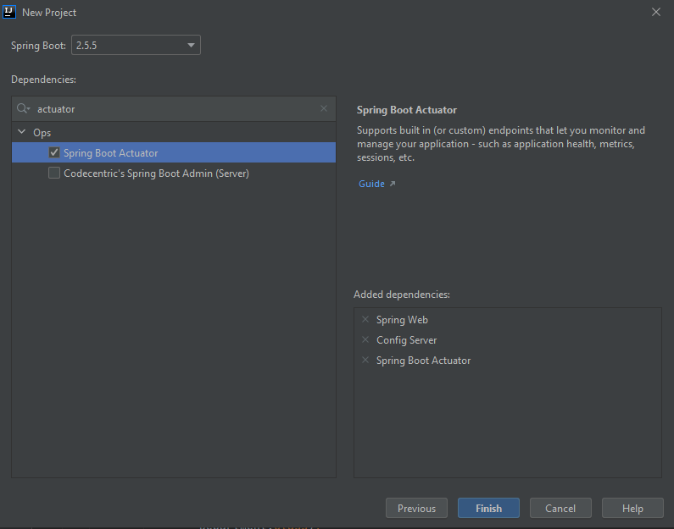
Step 01: Make Config Server

Slide 29
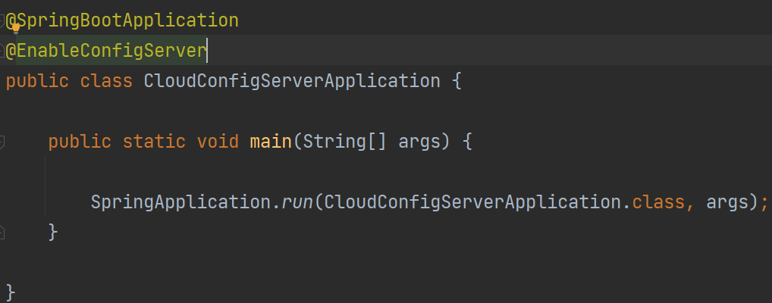
Spring boot config server

Slide 30
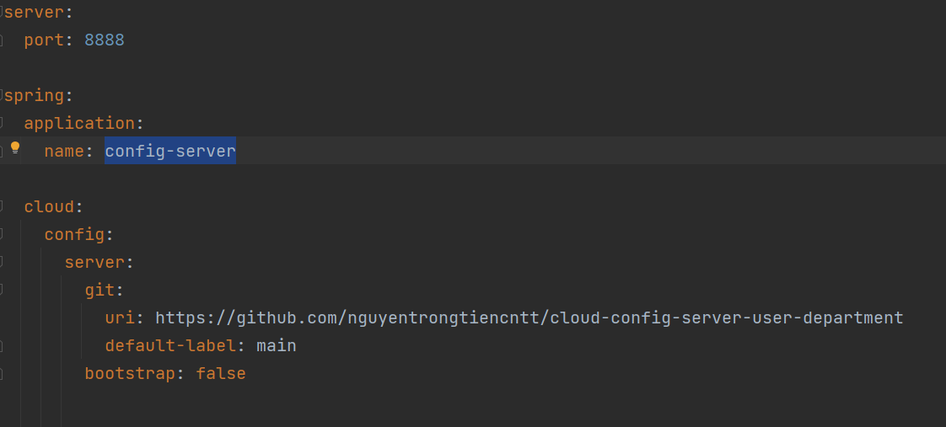
Spring boot config server

Slide 31
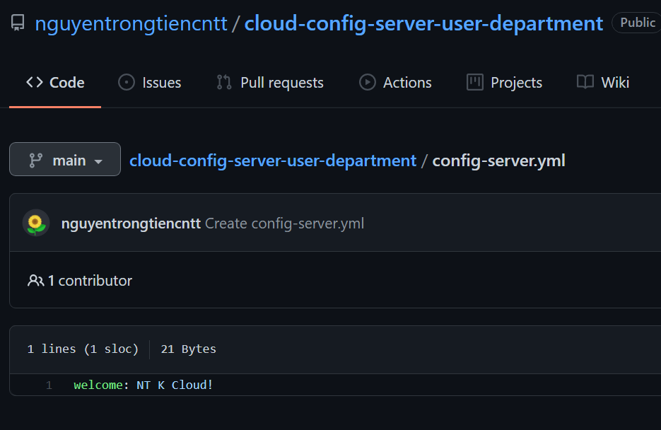
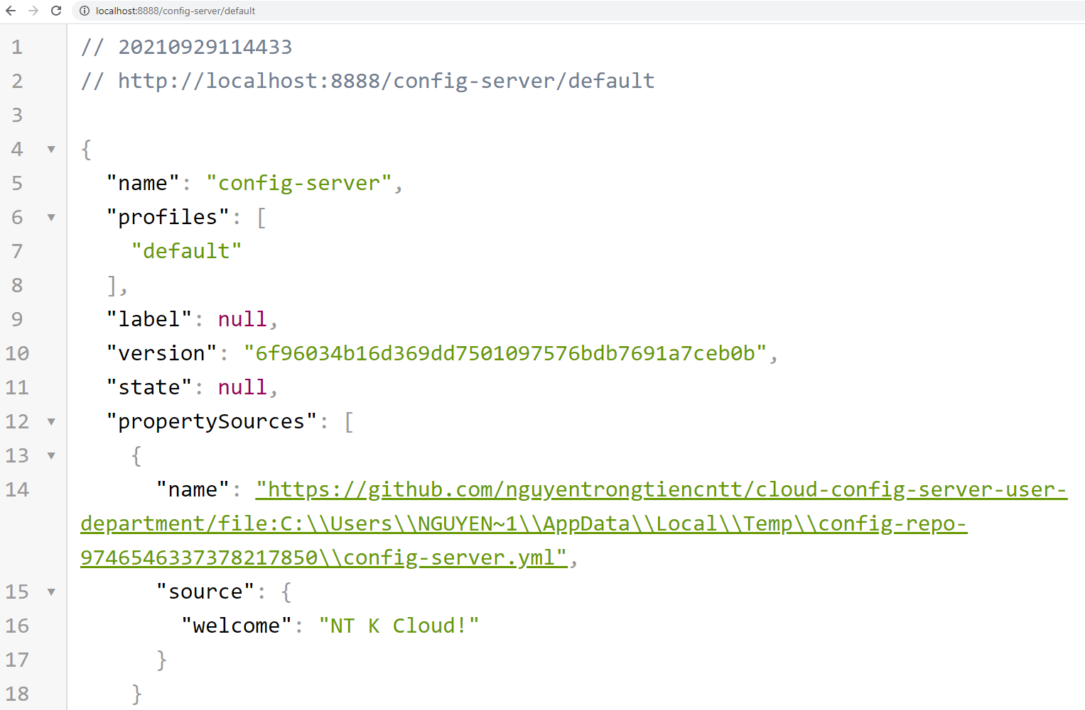
Spring boot config server

Slide 32

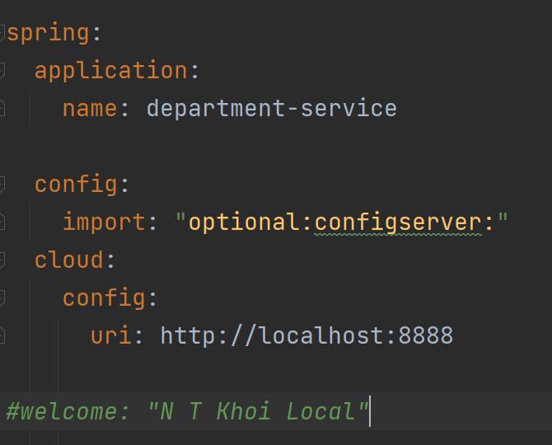
Step 02: Make Config Client

Slide 33

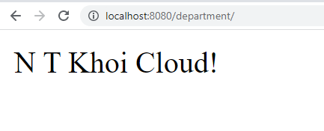
Make Config Client

Slide 34
API getway

Slide 35
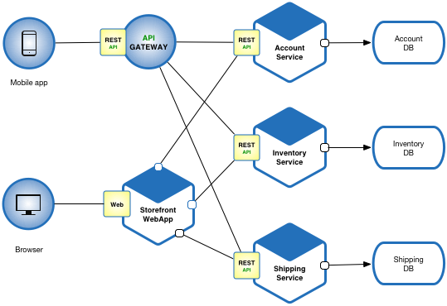
API getway service

Slide 36

API getway service

Slide 37
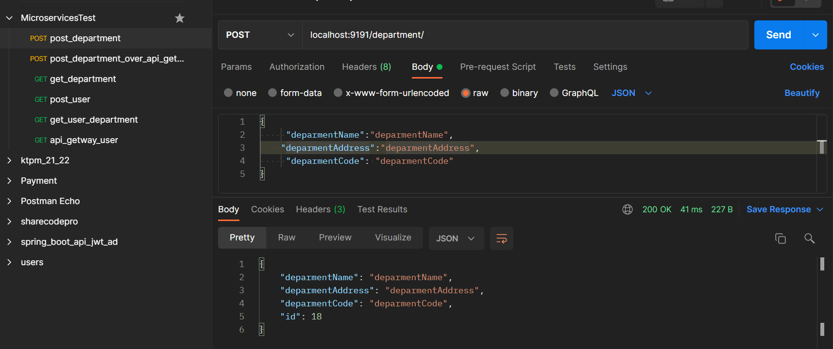
Explain: request over port 9191

Slide 38
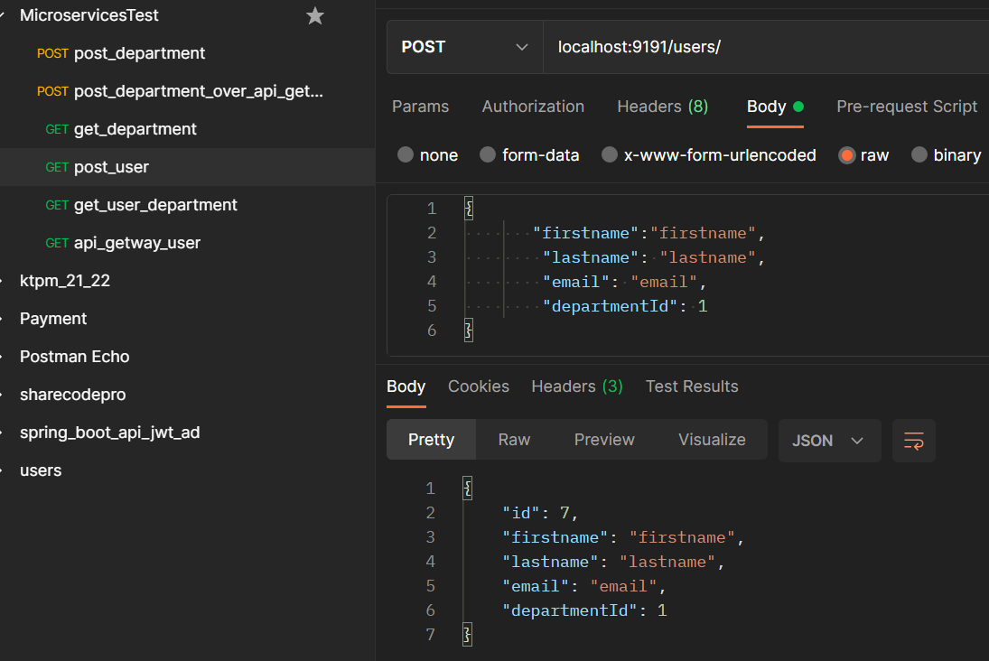
Explain: request over port 9191

Slide 39
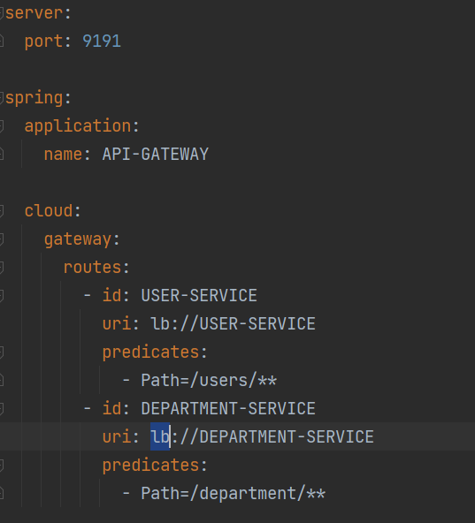
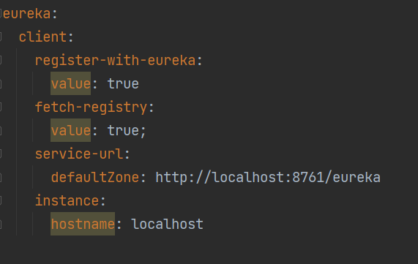
Step 01: API getway

Slide 40
Run api getway!

Slide 41
Explain: request over port 9191

Slide 42
Explain: request over port 9191

Slide 43
Thank you! and book introduction

